Slide 1
Module 5 Risk assessment and hazard avoidance
5.4P Hands on training: Personal protective equipment (PPE)
Notes:
Module: 5 Risk assessment and hazard avoidance
Melody Presentation: 5.4P. Hands on training: Personal protective equipment (PPE)
Learning objective: To recognize some different types of PPE and recognize how to carry out some basic techniques
Target audience: Dispatch Officer, Fire Brigade, Police, Ambulance Services
Title slide: Module 5: Risk assessment on scene and hazard avoidance
Result: After this slide the students know what part of the curriculum is discussed
Instructions for the teacher: This slide explains the content of the practical training in 5.4.P.
References for additional information:
Depicted illustration:
Picture source & IP:
Text source & IP:

Slide 2
Learning objective
To recognize some different types of PPE and recognize how to carry out some basic techniques
Notes:
Module: 5 Risk assessment and hazard avoidance
Melody Presentation: 5.4P. Hands on training: Personal protective equipment (PPE)
Learning objective: To recognize some different types of PPE and recognize how to carry out some basic techniques
Target audience: Dispatch Officer, Fire Brigade, Police, Ambulance Services
Title slide: Presentation: 5.4.P Personal Protective Equipment (PPE) hands on training
Result: After this slide the students know what part of the curriculum is discussed
Instructions for the teacher: This slide explains the content of the practical training in 5.4.P.
References for additional information:
Depicted illustration:
Picture source & IP:
Text source & IP:

Slide 3
Personal Protective Equipment (PPE) – practical I
The next 30 minutes we will practice donning and doffing
  Gloves
  Coverall
  Protective mask
Follow the instructions of your teacher
Notes:
Module: 5 Risk assessment and hazard avoidance
Melody Presentation: 5.4P. Hands on training: Personal protective equipment (PPE)
Learning objective: To recognize some different types of PPE and recognize how to carry out some basic techniques
Target audience: Dispatch Officer, Fire Brigade, Police, Ambulance Services
Title slide: Personal Protective Equipment (PPE) – practical I
Result: After this slide the students know what they will do for the next 30 minutes (practice gloves and simple masks)
Instructions for the teacher: This slide explain the content of the practical training in 5.4.P. Explain that donning means putting on and doffing means taking off
References for additional information:
Depicted illustration:
Picture source & IP:
Text source & IP:

Slide 4

Personal Protective Equipment (PPE) – practical II
Skin may only touch skin or the (clean) inside of your PPE
Skin may never touch the (dirty) outside of PPE
Mask goes on last and goes off last
Notes:
Module: 5 Risk assessment and hazard avoidance
Melody Presentation: 5.4P. Hands on training: Personal protective equipment (PPE)
Learning objective: To recognize some different types of PPE and recognize how to carry out some basic techniques
Target audience: Dispatch Officer, Fire Brigade, Police, Ambulance Services
Title slide: Personal Protective Equipment (PPE) – practical II
Result: After this slide the students will know these golden rules by heart.
Instructions for the teacher: Explain the golden rules:
Skin may only touch skin or the (clean) inside of your PPE. Another way of putting it would be: clean hands only touch clean / safe stuff.
Skin may never touch the (dirty) outside of PPE. Once you are in the ‘hotzone’ the outside of your PPE is always considered contaminated. Therefore, after PPE was put on, touching the outside with your hands MUST ALWAYS BE AVOIDED.
Once you apply these golden rules the chance of getting contaminated is minimalized. A helpful method when doffing gear is to describe to your buddy (partner) what you are going to do. For example: “I am now going to take off my glove, by grabbing the outside and pulling it off slowly”.
References for additional information:
Depicted illustration:
Picture source & IP:
Text source & IP:

Slide 5
Personal Protective Equipment (PPE) – practical III
General guidelines in advance (before donning):
  Shave. Tie up long hair.
  Eat and hydrate.
  Have a toilet break.
  Donning is done in the cold zone.
  Ask for assistance, always work in teams or a bubby system
  Wear appropriate clothing under your PPE (not too cold or too warm)
  Remove sharp objects (watches, rings, etc.)
  Choose the right size!
Notes:
Module: 5 Risk assessment and hazard avoidance
Melody Presentation: 5.4P. Hands on training: Personal protective equipment (PPE)
Learning objective: To recognize some different types of PPE and recognize how to carry out some basic techniques
Target audience: Dispatch Officer, Fire Brigade, Police, Ambulance Services
Title slide: Personal Protective Equipment (PPE) – practical III
Result: Make first responders aware of the general guidelines before applying PPE.
Instructions for the teacher: Discuss these guidelines with the students. Maybe some additional tips are given by students themselves? Some preparations may be the responsibility for the organization you are working for (e.g. make sure the proper PPE is available), other preparations are your own responsibility (e.g. shaving when on duty).
References for additional information:
Depicted illustration:
Picture source & IP:
Text source & IP: RIVM, P54, module 3&4

Slide 6
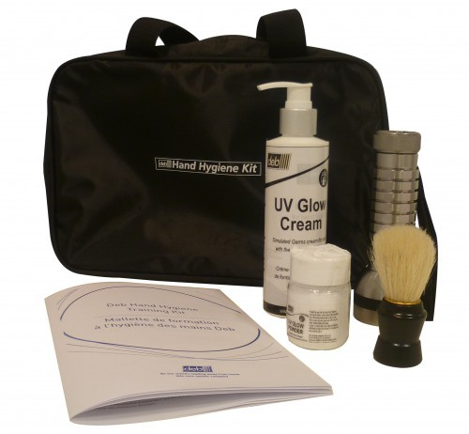
Donning and doffing gloves
Donning:
  Choose the right size gloves
  Remove jewellery, (sharp objects)
  Wash your hands
  Put on the gloves, make sure there are no folds
Doffing
DEB UV Hand Hygiene Training Kit
Melody Presentation: 5.4P. Hands on training: Personal protective equipment (PPE)
Notes:
Module: 5 Risk assessment and hazard avoidance
Melody Presentation: 5.4P. Hands on training: Personal protective equipment (PPE)
Learning objective: To recognize some different types of PPE and recognize how to carry out some basic techniques
Target audience: Dispatch Officer, Fire Brigade, Police, Ambulance Services
Title slide: Donning and doffing gloves
Result: First responders will become aware of the procedures regarding donning and doffing disposable gloves.
Instructions for the teacher: Explain that doffing of disposable gloves should be performed using a specific procedure, because they are potentially contaminated.
Donning disposable gloves requires no specific sequence. However, be aware that rings and long fingernails can damage your gloves. Therefore, remove rings and other jewelry and clip long fingernails short. Make sure gloves fit you properly and there are no folds.
Doffing disposable gloves does require a specific sequence to avoid contamination (see image and movies):
With the thumb and index finger of one hand, grab the outside of the glove nearby the wrist of the other hand (image 1)
Peel the glove off with your thumb and index finger, away from your wrist (image 2)
Keep the doffed glove in your other still gloved hand (image 3), or dispose of the glove directly in a waste container
Slip a finger of your clean hand (without the glove) under the glove of the other hand (image 4). Do not touch the outside of the glove!
Peel the glove off with your finger, away from your wrist (image 5), turning the glove inside out.
Fold the first glove within the second glove when peeling the second glove off from your hand (image 6). Dispose of the glove(s) directly in a waste container.
For an instruction movie of the sequence in total, show movie 5.4.P Doffing Gloves I
For an instruction movie of the sequence in total using a cross-contamination kit, showing contamination using fluorescent dye and a UV-lamp, show movie 5.4.P Doffing Gloves II
For an instruction movie of the sequence in total with and without a cross-contamination kit, show movie 5.4.P Doffing Gloves III
The cross-contamination kit used in this example is a DEB UV Hand Hygiene Training Kit, available on: https://www.careshop.co.uk/infection-control/hand-hygiene/hand-hygiene-accessories/deb-uv-hand-hygiene-training-kit.html
References for additional information: instruction movie of the sequence in total: 5.4.P Doffing Gloves I
Depicted illustration: An image showing the six steps in removing a potentially contaminated disposable glove.
Picture source & IP: Stills taken from instruction movie of the sequence in total: 5.4.P Doffing Gloves I
Text source & IP: RIVM

Slide 7
Donning and doffing masks
Donning:
  Choose the right size
  Remove jewellery
  Wash your hands
  Adjust after donning
    Nose clip
    General fit
Doffing
Melody Presentation: 5.4P. Hands on training: Personal protective equipment (PPE)
Notes:
Module: 5 Risk assessment and hazard avoidance
Melody Presentation: 5.4P. Hands on training: Personal protective equipment (PPE)
Learning objective: To recognize some different types of PPE and recognize how to carry out some basic techniques
Target audience: Dispatch Officer, Fire Brigade, Police, Ambulance Services
Title slide: Donning and doffing masks
Result: First responders will become aware of the procedures regarding donning and doffing disposable face masks, in this case a FFP3 respiratory mask
Instructions for the teacher: The Instructions of the pictures should match the instructions below. More importantly than theoretically explain how to do donning and doffing of a mask is to SHOW the students yourself how to do it!
Explain that donning disposable face masks should be done according to the depicted instructions (left picture) to make sure they fit well.
Explain that doffing disposable face masks require the specific sequence as depicted in the instructions to avoid contamination of your hands
Remind the students that gloves should be removed first, before you touch your head. In the doffing sequence, the person is still wearing his gloves while doffing his mask. Although he is not touching his face, it is not advisable to still wear gloves.
Slide your thumbs under both headbands of the face mask (image 1)
Pull the elastic bands slightly behind your head (image 2)
Carefully move the middle part of the elastic band over your head, while keeping the mask pushed against your face by stretching the elastic bands slightly (image 3)
Push the mask away from your face (image 4), and dispose without touching anything but the elastic band
For an instruction movie of the sequence of doffing an FFP3 masks, show movie 5.4 Doffing FFP3 mask
References for additional information:
Depicted illustration: An image showing the four steps in doffing a disposable respirator mask.
Picture source & IP: COVID-19-guidance-wearing-and-removing-personal-protective-equipment-healthcare-settings-updated.pdf
Text source & IP: RIVM, P54, module 3&4

Slide 8
Donning and doffing coverall, gloves, and mask
Donning:
  Choose the right size
  Remove jewellery
  Make sure there are no holes
Doffing
DEB UV Hand Hygiene Training Kit
Melody Presentation: 5.4P. Hands on training: Personal protective equipment (PPE)
Notes:
Module: 5 Risk assessment and hazard avoidance
Melody Presentation: 5.4P. Hands on training: Personal protective equipment (PPE)
Learning objective: To recognize some different types of PPE and recognize how to carry out some basic techniques
Target audience: Dispatch Officer, Fire Brigade, Police, Ambulance Services
Title slide: Donning and doffing coverall, gloves, and mask
Result: First responders will become aware of the procedures regarding donning and doffing disposable coveralls, gloves, and masks in the proper sequence.
Instructions for the teacher: Explain that doffing a coverall Does follow a specific sequence of guidelines.
Full PPE: gloves, coverall and FFPx masks (image 1).
With gloves on, slide the hood back: don’t touch your head with the gloves! (image 2)
With gloves on, zip open the coverall, and touching only the outside of the coverall, slide the coverall back over your shoulders (image 3)
Doff your gloves using the proper procedure (image 4 and see also slide 6)
Pull your arms out of the coverall, touching the inside of the coverall only (image 5)
Strip the coverall down to your shoes/boots, only touching the inside of the coverall (image 6)
Step out of the coverall, one foot at the time, and remove face mask using the proper procedure (image 7, see also slide 7)
Fold the coverall into a smaller package, by only touching the inside of the coverall and dispose of it (image 8)
For an instruction movie of the sequence in total, show movie 5.4.P Doffing Coverall I
For an instruction movie of the sequence in total with and without a cross-contamination kit, show movie 5.4.P Doffing Coverall II
The cross-contamination kit used in this example is a DEB UV Hand Hygiene Training Kit, available on: https://www.careshop.co.uk/infection-control/hand-hygiene/hand-hygiene-accessories/deb-uv-hand-hygiene-training-kit.html
References for additional information: instruction movie of the sequence in total, show movie 5.4.P Doffing Coverall I
Depicted illustration: An image showing the eight steps in removing a potentially contaminated disposable coverall.
Picture source & IP: Stills taken from instruction movie of the sequence in total: 5.4.P Doffing Gloves I
Text source & IP: RIVM

Slide 9
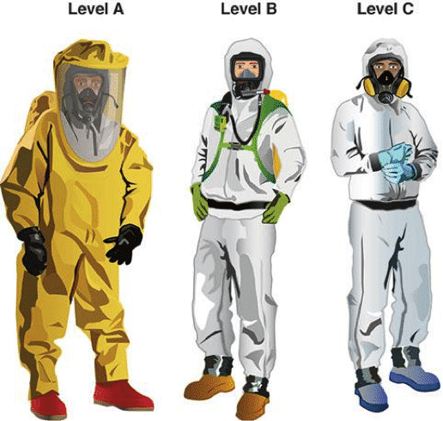
Specific Personal Protective Equipment (PPE)
Procedures for donning and doffing of your specific PPE is not included here.
If applicable for your task, this must be addressed by your organization.
Procedures will be specific for your PPE and instructions must be given by a (certified) instructor.
Melody Presentation: 5.4P. Hands on training: Personal protective equipment (PPE)
Notes:
Module: 5 Risk assessment and hazard avoidance
Melody Presentation: 5.4P. Hands on training: Personal protective equipment (PPE)
Learning objective: To recognize some different types of PPE and recognize how to carry out some basic techniques
Target audience: Dispatch Officer, Fire Brigade, Police, Ambulance Services
Title slide: Specific Personal Protective Equipment (PPE)
Result: After this slide all students are well aware that specific PPE requires specific procedures and training, which must be given by your own organization.
Instructions for the teacher: Since there is such a variety of PPE on the market and learning to use some of it is very time consuming, it is impossible to include this in this course. Make sure you know how to use the PPE used in your own organization, if this is your responsibility. Otherwise, make sure you know who the experts are within your organization.
References for additional information:
Depicted illustration:
Picture source & IP: https://www.eyeweb.com/what-are-the-4-levels-of-ppe
Text source & IP: RIVM, P54, module 3&4

Slide 10
Take Home Message
Skin may only touch skin or the (clean) inside of your PPE
Skin may never touch the (dirty) outside of PPE
Mask goes on last and goes off last
Melody Presentation: 5.4P. Hands on training: Personal protective equipment (PPE)
Notes:
Module: 5 Risk assessment and hazard avoidance
Melody Presentation: 5.4P. Hands on training: Personal protective equipment (PPE)
Learning objective: To recognize some different types of PPE and recognize how to carry out some basic techniques
Target audience: Dispatch Officer, Fire Brigade, Police, Ambulance Services
Title slide: Take Home Message
Result: After this slide all students are well aware of the take home message.
Instructions for the teacher: Remind the students of the main three bullet points.
References for additional information:
Depicted illustration:
Picture source & IP:
Text source & IP: RIVM

Slide 11

Thank you for your attention
Melody Presentation: 5.4P. Hands on training: Personal protective equipment (PPE)
Notes:
Module: 5 Risk assessment and hazard avoidance
Melody Presentation: 5.4P. Hands on training: Personal protective equipment (PPE)
Learning objective: To recognize some different types of PPE and recognize how to carry out some basic techniques
Target audience: Dispatch Officer, Fire Brigade, Police, Ambulance Services
Title slide: Thank you for your attention
Result:
Instructions for the teacher:
References for additional information:
Depicted illustration:
Picture source & IP:
Text source & IP:

