Slide 1
Zoom Meetings Housekeeping Slides
Add and customize the following slide to your meeting presentation deck to demonstrate the following:
Adjust VoIP audio settings
Switch to telephone audio
View participants and raise hand
Chat
Please view the notes on the following slide for a step-by-step guide to the animations.

Slide 2
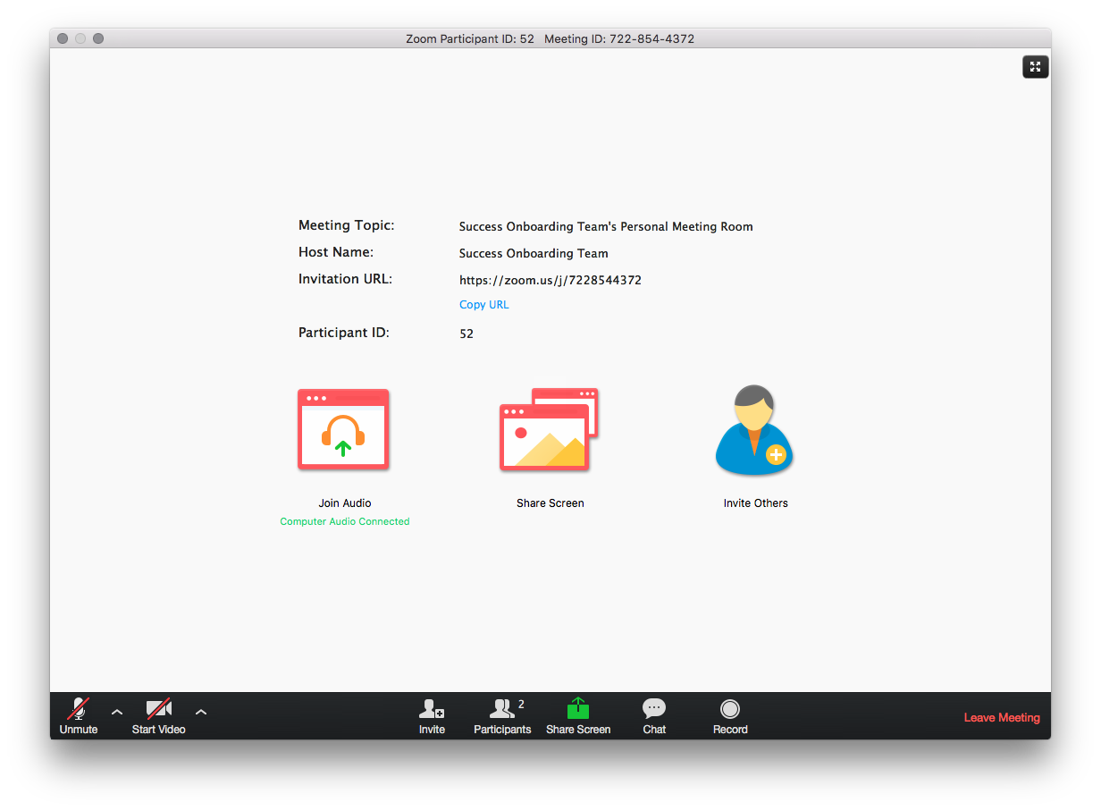
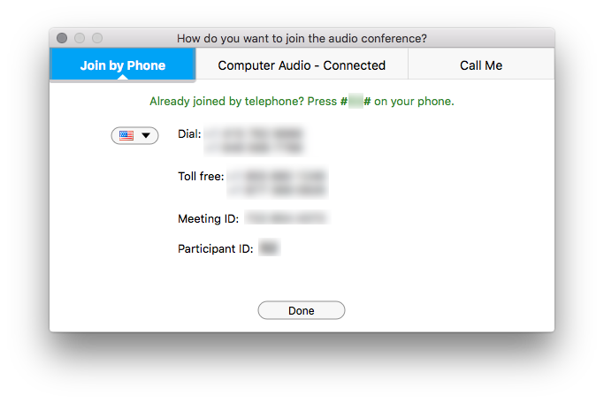
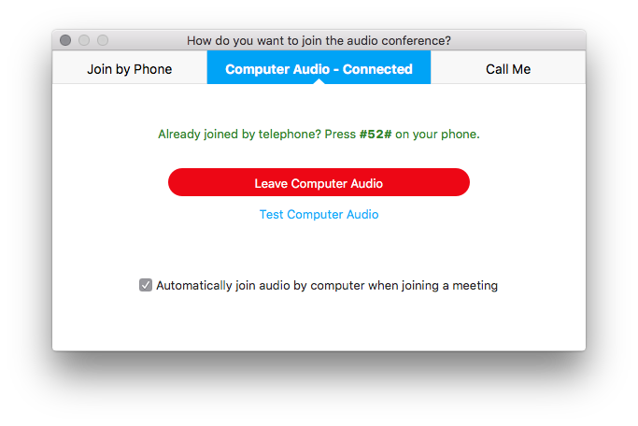
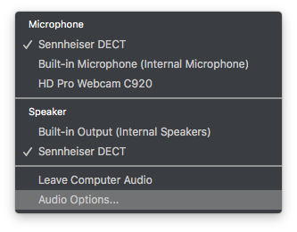
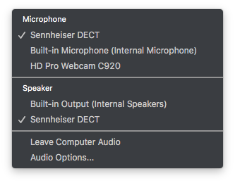
Housekeeping – Zoom Meeting viewer interaction
Notes:
Animations step-by-step guide:
Click 1 – Highlights audio menu
Click 2 – Highlights Audio Options
Click 3-4 – Opens Audio Options and Join By Phone

Slide 3
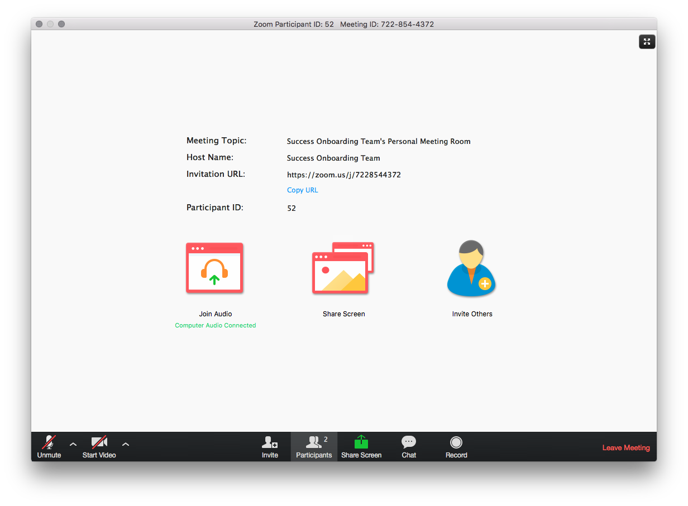
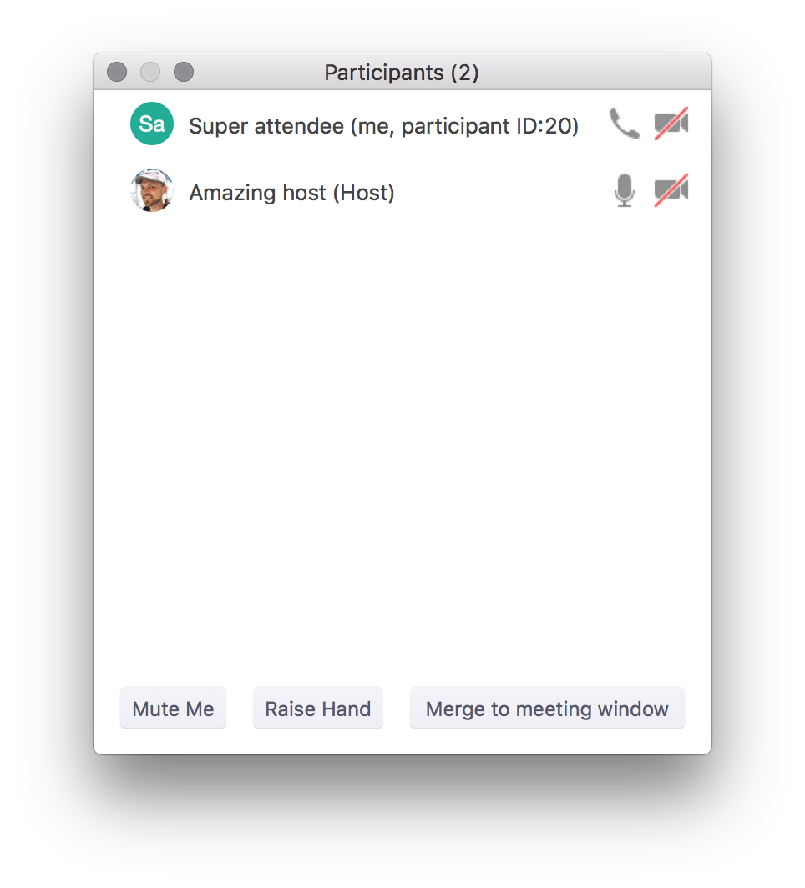
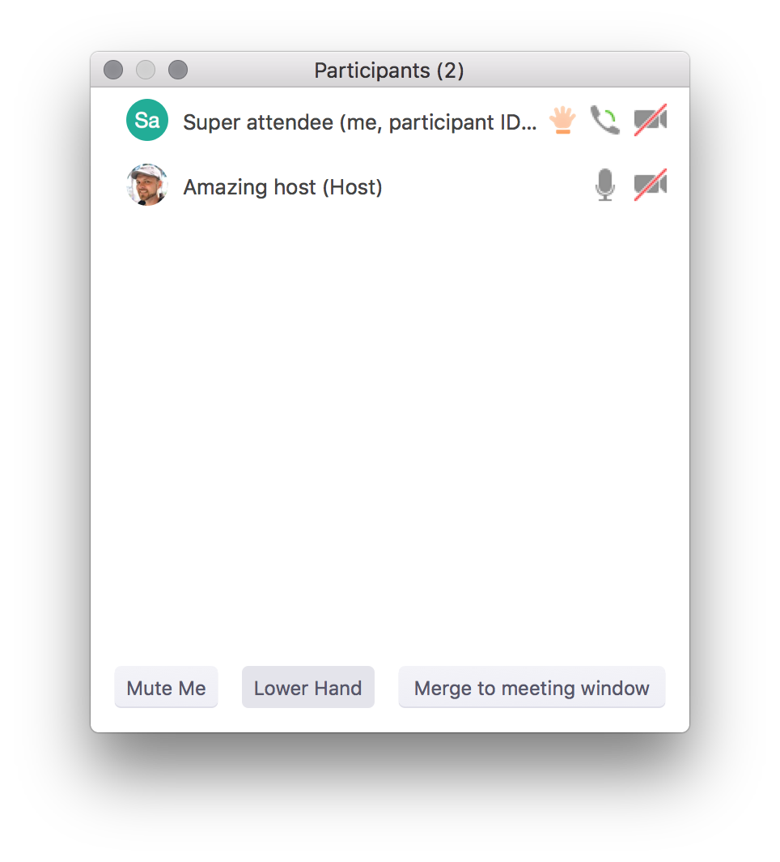
Housekeeping – Zoom Meeting viewer interaction
Notes:
Animations step-by-step guide:
Click 1 – Show hand raised

Slide 4
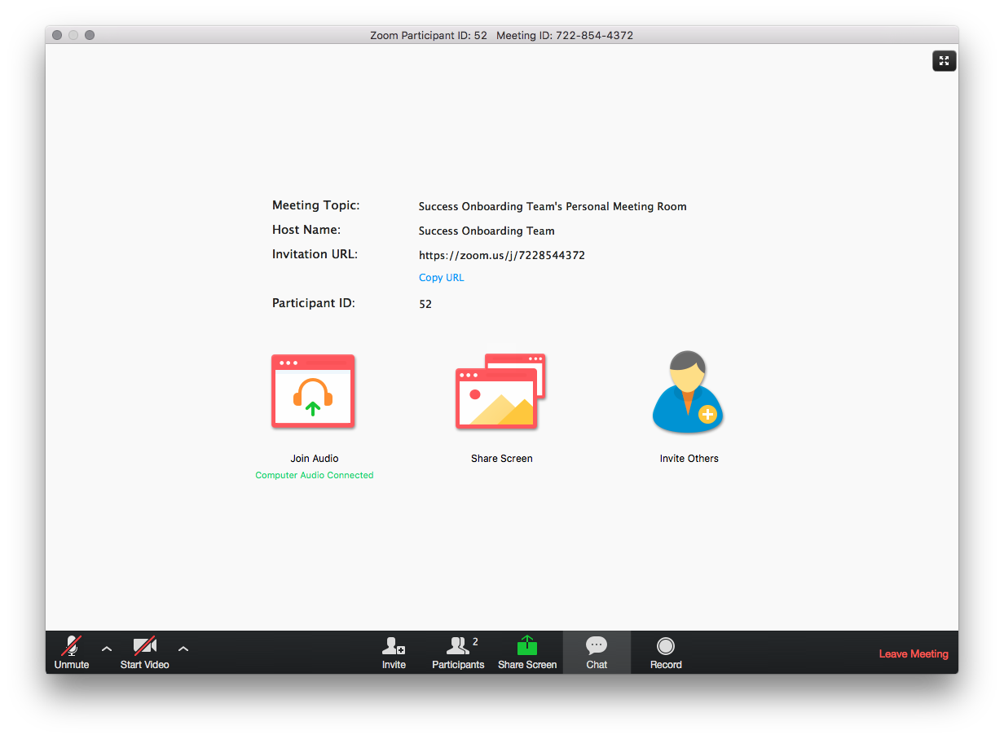
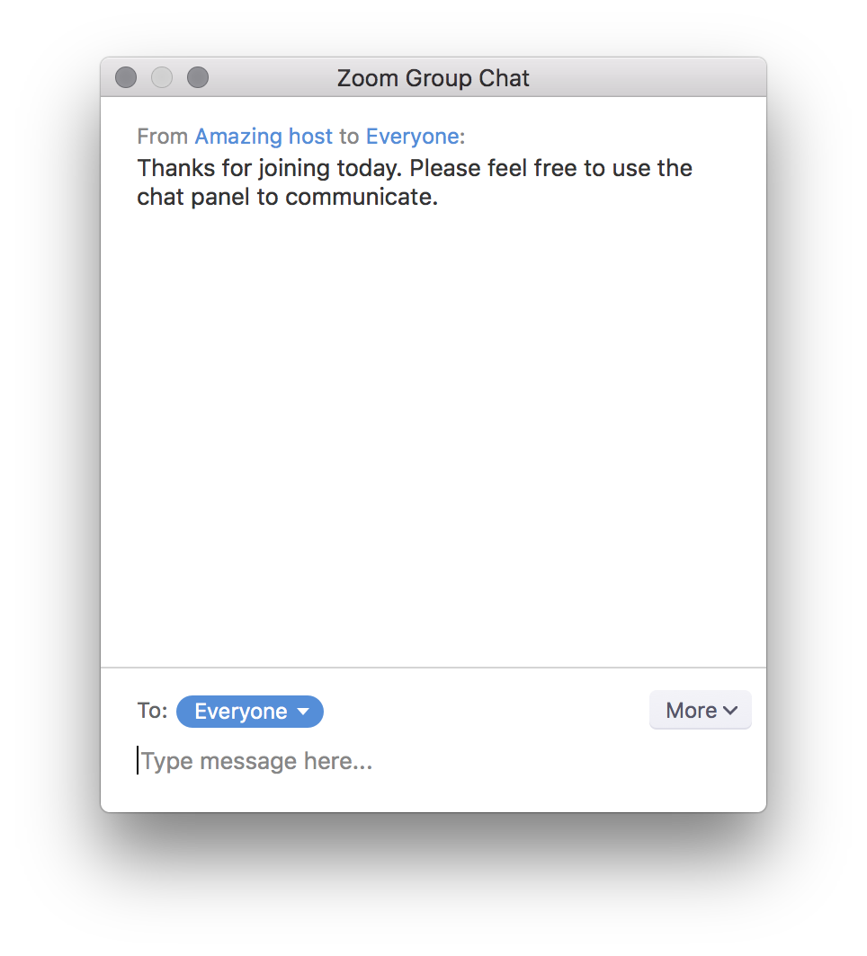
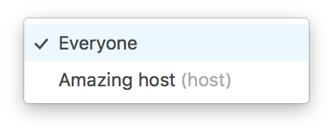
Housekeeping – Zoom Meeting viewer interaction
Notes:
Animations step-by-step guide:
Click 1 – Show private chat

